Slide 1

TAPIT
INTERNET OF THINGS
Lecture 10:
OPENHAB

Slide 2


TAPIT
The open Home Automation Bus (openHAB, pronounced ˈəʊpənˈhæb) is an open source, technology agnostic home automation platform which runs as the center of your smart home!
Notes:
https://www.openhab.org/docs/

Slide 3
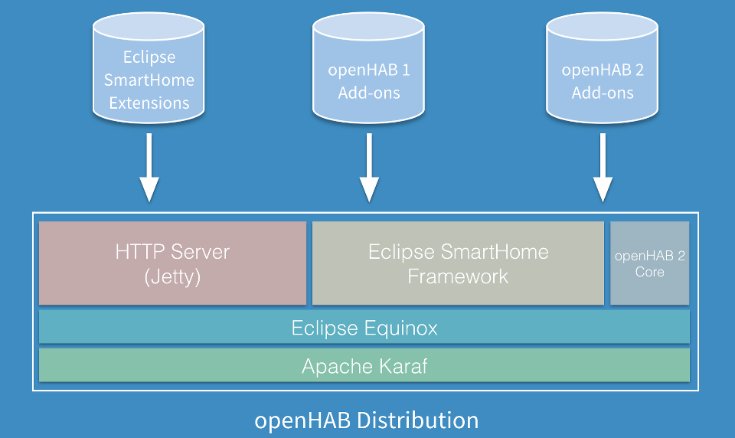
TAPIT

Slide 4
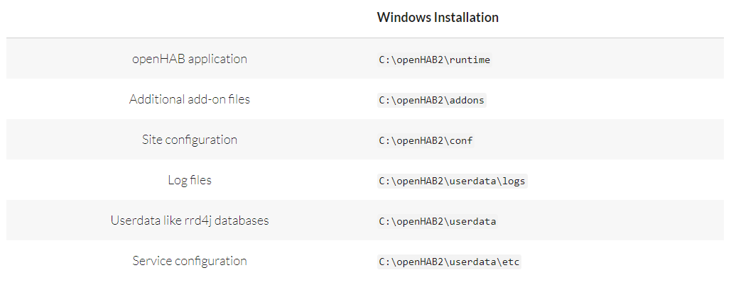
TAPIT
Notes:
\runtime: Chứa các file thực thi của hệ thống như start, stop, status,...
\addons: Chứa các addons file như binddings, actions, persistence,...
\conf: Chứa các file cấu hình như things, sitemap, items, rules,...
\userdata: Hoạt động như một rrd4j databases: là một hệ thống lưu trữ và ghi nhật ký dữ liệu thay đổi theo thời gian thực hiệu suất cao.
\userdata\logs: Chứa các file logs để theo dõi hoạt động của OH2 và phục vụ debug.

Slide 5
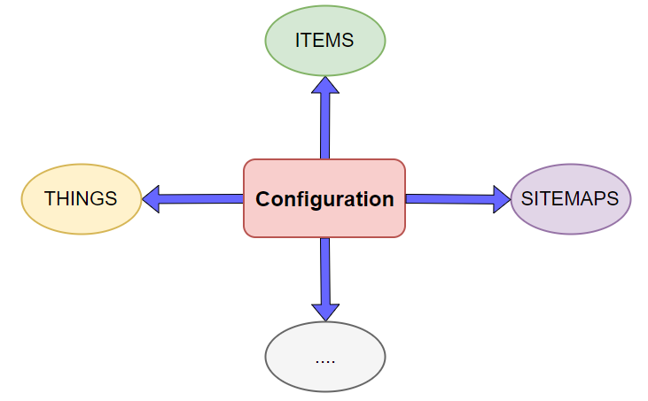
TAPIT

Slide 6
TAPIT
THINGS
Represent the physical layer of an openHAB system, tell openHAB which physical entities (devices, web services, etc...).
Connected to openHAB through bindings
Each Thing provides one or more Channels to access its functionality and these Channels can be linked to items.
Things are a new concept in openHAB 2.
Notes:
http://docs.openhab.org/configuration/things.html

Slide 7
TAPIT
ITEMS
Represent all properties and capabilities of the user’s home automation.
Items are basic data types and have a state which can be read from, or written to.
Two methods for defining Items:
+ Through Paper UI
+ Through text .items files in the items folder
Notes:
http://docs.openhab.org/configuration/items.html

Slide 8
TAPIT
ITEMS
itemtype itemname "labeltext [stateformat]" <iconname> (group1, group2, ...) ["tag1", "tag2", ...] {bindingconfig}
Item type: defines what kind of state can be stored in that Item and which commands the Item will accept (Ex: Color, String, Switch, Dimmer, etc)
Item name: the Item name is used to uniquely identify an Item, it must be unique across all .items files in openHAB configuration.
Label text: used to describe an Item in a human-readable way
[stateformat]: The Item definition determines the Item’s textual state presentation
Iconname: appears between angle brackets “<>”, used to select the image to display next to an Item name when using one of openHAB’s Uis.
Group: a special Item type that can be used to define a category or collection into which you can combine other Items or Groups. An Item may be put into one or more groups, and groups may be nested inside other groups:
Group groupname ["labeltext"] [<iconname>] [(group1, group2, ...)]

Slide 9
TAPIT
SITEMAPS
Used to select and prepare elements to collect Things and Items in order to compose a user-oriented presentation of this setup for various User Interfaces (UIs), including BasicUI, the Android openHAB app and others.
Sitemaps are text files with the .sitemap extension, and are stored in the $OPENHAB_CONF/sitemaps directory.
Notes:
http://docs.openhab.org/configuration/sitemaps.html

Slide 10
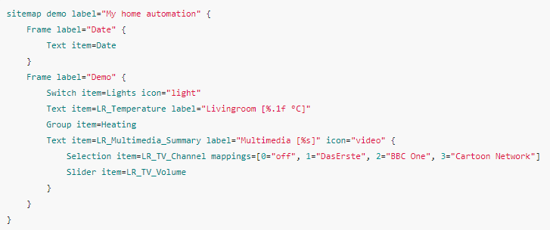
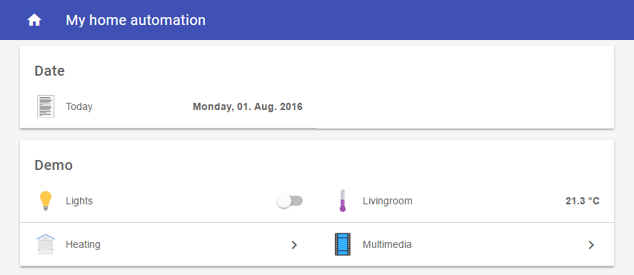
SITEMAPS
TAPIT

Slide 11
SITEMAPS
TAPIT
Special Element ‘sitemap’
sitemap <sitemapname> label="<title of the main screen>" {
[all sitemap elements]
}
- sitemapname shall always be equal to the Sitemaps file name. Ex: the sitemapname in a sitemap file named demo.sitemap must be «demo»
- label is free text and will be shown as the title of the main screen

Slide 12
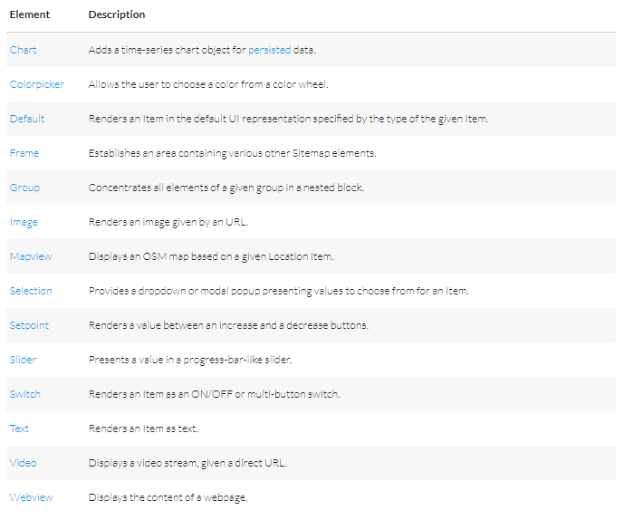
SITEMAPS
TAPIT
Element Types
Notes:
http://docs.openhab.org/configuration/sitemaps.html#element-types

Slide 13
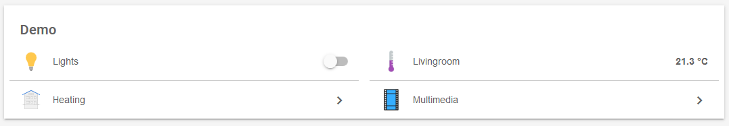
SITEMAPS
TAPIT
Element Types ‘Frame’
Frame [label="<labelname>"] [icon="<icon>"] {
[additional sitemap elements]
}
Example:
Frame label="Demo" {
Switch item=Lights icon="light" //# and so on...
}
Result::

Slide 14

SITEMAPS
TAPIT
Element Types ‘Text’
Text [item=<itemname>] [label="<labelname>"] [icon="<iconname>"]
Example:
Text item=Temperature label="Livingroom [%.1f °C]" icon="temperature"
Result:

Slide 15


SITEMAPS
TAPIT
Element Types ‘Switch’
Switch item=<itemname> [label="<labelname>"] [icon="<iconname>"] [mappings="<mapping definition>"]
Example:
Switch item=LR_CeilingLight label="Ceiling Light" icon="light"
Switch item=LR_TV_Channel label="TV Channel" mappings=[0="DasErste", 1="BBC One", 2="Cartoon Network"]
Result:

Slide 16
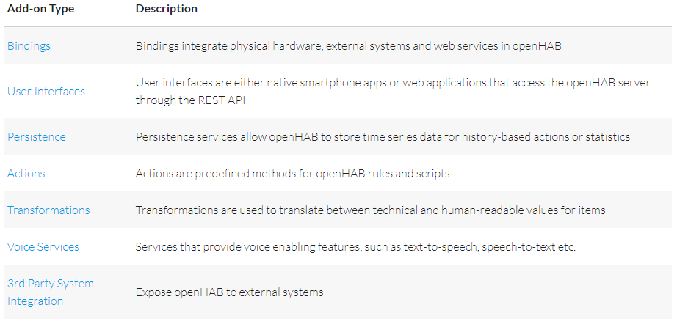
ADD-ONS
TAPIT
- All add-ons for openHAB 2 are part of the distribution.
This includes all new 2.0 bindings as well as all 1.x add-ons that were reported to be compatible.
Add-ons can be easily installed through the Paper UI
Notes:
http://docs.openhab.org/addons/index.html

Slide 17
MQTT BINDING
TAPIT
Allows openHAB to act as an MQTT client, so that openHAB items can send and receive MQTT messages to/from an MQTT broker
Step to use MQTT Bindings:
Install the MQTT Bindings through the Paper UI.
Config services/mqtt.conf file
Config Item for inbound or outbound messages
- Choose item to display on the sitemaps
Notes:
http://docs.openhab.org/addons/bindings/mqtt1/readme.html#transport-configuration

Slide 18

TAPIT

